Slide 1

When the going gets tough…
Prison Officer Summer Symposium
Keble College
Oxford
14th-15th August 2017
Presented by
Professor Jo Clarke
Notes:
Intro self
Talk about the title
Led to thinking about what resilience actually is

Slide 2
Individual Resilience
(with thanks to Jasmine James)
Relative resistance to environmental risk experiences, or the overcoming of stress or adversity.” Rutter (2007).
A universal capacity to cope with change and bounce back from adversity (Grothberg, 1997).
A process affected through various factors including:
  attainment and sustainment of positive relationships (connectedness)
  The ability to create and execute realistic plans, to problem solve and to manage strong impulses (competence and contribution).
  A positive self-concept

Slide 3
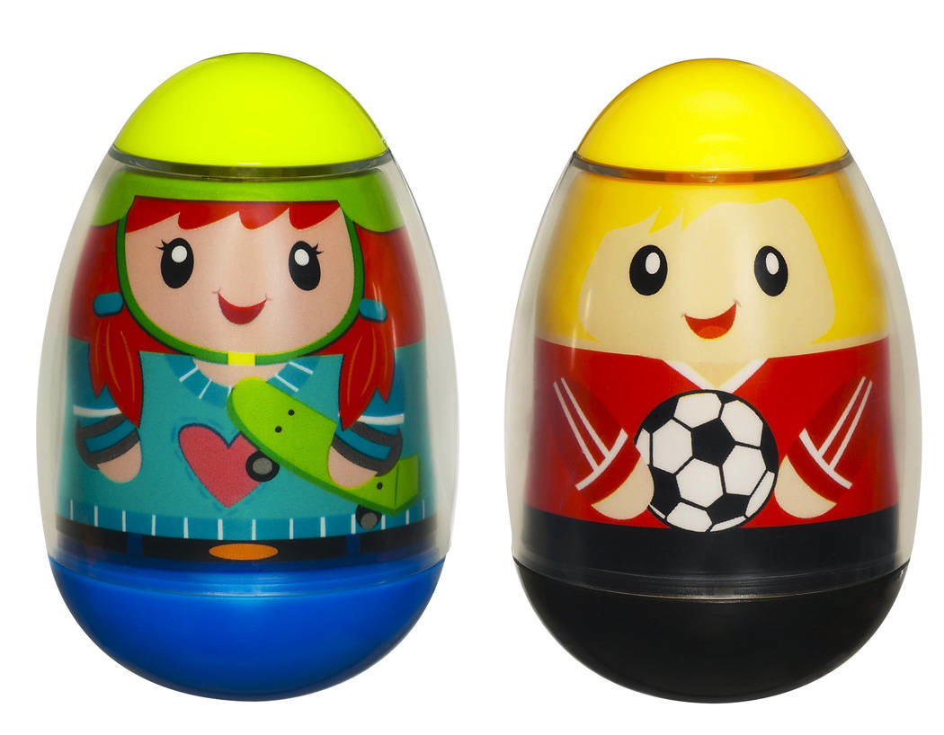
Notes:
Do you remember Weebles – they wobble but they don’t fall down! This is a metaphor for resilience!
Explain paperclips and keeping head clear of them – what they represent is Rumination – pre-occupation with emotional upset. This is stress
Work in a profession where there is plenty to ruminate about
So what should we do when the going get’s tough

Slide 4
Why is resilience important?
A Critical Occupation
One where there is high risk of exposure to traumatic events or material that may, under certain circumstances, exert critical impact on the psychological well-being of those within it
(Paton & Violanti,1996)
Members of critical occupations also pay a critical role in protecting the communities they serve

Slide 5
When the going gets tough….
The tough
WAKE UP
Notes:
What do we mean by waking up?
It’s really the difference between presence of mind and absent mindedness
Absent mindedness (day dreaming) can lead to waking nightmares. Let’s put that in work setting – being absent minded doing LBB’s, serving food in a seg unit, working, unlocking doors in the morning

Slide 6

Presence of mind
Notes:
1 Presence of mind

Slide 7
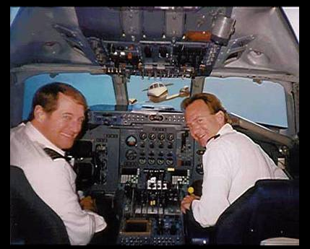
Absent minded

Slide 8

Lost mind

Slide 9
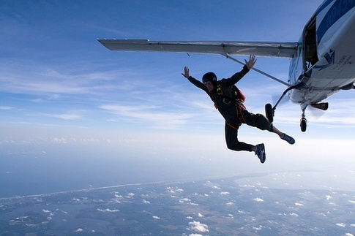
Out of mind

Slide 10
Top tips for Presence of Mind
What’s
Important
Now
Be in the room you’re in
Notes:
From now on, practice keeping your attention focussed on WIN

Slide 11
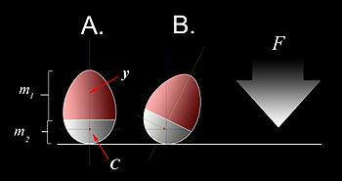
Notes:
The science behind weebles!

Slide 12
Model of Dynamic Adaptation: Points on Intervention (Clarke 2004)
Intervention 2
Negative
Psychological
Outcome
Intervention 3
Intervention 4
Intervention 1

Slide 13
Exercise
In small groups of 4 or 5, discuss the costs of your work. What is the personal impact on the job on your emotional, physical, mental health? What are the signs for you that work is having a negative impact?

Slide 14
Model of Dynamic Adaptation: Points on Intervention (Clarke 2004)
Intervention 2
Positive
Psychological
Outcome
Negative
Psychological
Outcome
Intervention 3
Intervention 4
Intervention 1

Slide 15
Exercise
In small groups of 4 or 5, discuss the costs of your work. What is the personal impact on the job on your emotional, physical, mental health? What are the first signs for you that work is having a negative impact?
In small groups of 4 or 5, discuss the rewards of your work. What do you love? What is the impact on your emotional, physical and mental health? What are the first signs for you that work is having a positive impact?

Slide 16
Model of Dynamic Adaptation: Points on Intervention (Clarke 2004)
Intervention 2
Positive
Psychological
Outcome
Static Factors
Critical
Occupation
Stable Factors
Negative
Psychological
Outcome
Dynamic
Factors
Intervention 3
Intervention 4
Intervention 1

Slide 17
Levels of Intervention
Primary (Intervention Points 1 & 2)
  Aims to promote good psychological health and requires action on its determinants to prevent dysfunctional outcome
Secondary (Intervention Points 2 & 3)
  Involves early detection of dysfunctional outcome, followed by appropriate intervention
Tertiary (Intervention Point 4)
  Aims to reduce the impact of dysfunctional outcome and promote quality of live through active rehabilitation
Notes:
In essence, all strategies have to be endorsed/supported by the organisation, but the individual does have a duty of care to themselves and for the remainder of this session, that is where we will focus our attention

Slide 18
For the rest of the session (except 10 mins wrap up)
Discuss a range of strategies/actions/things to do that could help build resilience in your team/wing/unit
Try to identify examples of primary, secondary and tertiary strategies that could be used at intervention points 1, 2 and 3
Recognise that some of the easiest and cheapest (even free) strategies, might be the most effective
Don’t be put off by ideas that might cost money. Where resilience if concerned there may well have to be a spend to save

Slide 19
Some inspiration
Richard Branson
  Look after your staff, they’ll look after your customers - and stay loyal to your company
Julian Richer (Richer Sounds)
  A happy workforce supplies good customer service, boosts sales, decreases complaints, and eradicates theft and absenteeism.

