Slide 1
Client Witness Statements
Client Statements
XXX My Buddy has been a great help to me. He got me a cell move so that I didn’t have to go up and down stairs anymore. He gets my meals for me and fills my flask up whenever I need him to. He also helps me clean my cell and gets my kit change and helps me make my bed for me.
XXX is always checking to see if I am alright and if I need anything. I consider him a friend as well as a great Buddy. I think the Buddy system is a great one and I am grateful for the help I get from it.
(A man, who suffers mental health problems, who had previously tried to commit suicide by jumping off a building and now had locked ankles following numerous operations, and walks on crutches. He is a easy target for bullying and was recently assaulted. He now has a cell opposite his Buddy on the same landing).
Notes:
Client Witness State
Ment 1

Slide 2
Client Witness Statements
Having been in prison in 2014, in a wheelchair, I begged for help with collecting meals, kit change, bed change, and got nothing. I was abused, bullied and frightened. Since 2015 (when the Buddy service started) I now have a quality of life, food, clothes, help with exercise, Well done, Thank you.
I find my Buddy to be attentive, very positive and always helpful and encouraging. He helps me with the tasks I find too difficult to do and also actively encourages me to do what I can for myself. He walks with me to exercise and back and encourages me to go out on exercise. He treats me with respect constantly and is understanding of my health issues and memory problems.
(A man with early onset dementia)
Notes:
Client Witness State
Ment 2

Slide 3
Client Witness Statements
This scheme is excellent. My Buddy provides the help and support I need to maintain health and hygiene. He covers the day to day tasks I’m unable to do such as cleaning my cell thoroughly and making my bed. He helps at meal times and ensures that I have water, as I scald myself. My Buddy is aware of the difficulties I have and he encourages me to maintain personal hygiene and takes me to ‘F’ wing so that I can use the disabled showers.
I have great difficulty pushing my wheelchair and can manage a few metres only but now I am able to access prison services such as library, education and even fresh air / exercise, thanks to my Buddy pushing me. He ensures that I can access and use the stair lift safely each day. He (gently) reminds me to consider what I eat.
Being a wheel chair user I feel vulnerable when the wing is busy and tend to stay in my cell.
My Buddy is happy to spend time with me and we share ideas, thoughts, beliefs and anything else I wish to discuss. This makes me feel valued.
I can not praise this scheme enough, it alleviates many difficulties I face and helps to retain my dignity. It also lifts my spirits as I know I have support.
Notes:
Client Witness State
Ment 3

Slide 4
Client Witness Statements
I am sincerely grateful to my Buddy. He is always happy and willing to help and it is obvious to me that he gets a sense of satisfaction from knowing that he has provided the support that was needed. I would feel lost without this service and fear I would suffer hardship.
One word to describe my Buddy is excellent! He is good at cleaning and as I am blind I’ve taught him to help guide me and he is good at it. He introduces himself at the door. He listens, we chat, we are good company. He is very careful to put everything back in the right place so I know exactly where it all is. He also helped me put in an app for health care for toe nail cutting. 2 apps have now gone in, still waiting to hear.
Notes:
Client Witness State
Ment 4

Slide 5
Client Witness Statements
My Buddy is the best! He comes every morning as soon as we are unlocked and makes sure I am fit and happy. He copes with my needs and is always happy to be helpful. He pushes me for my meds every morning, he keeps my cell clean and tidy, gets my meals and does everything he can to look after me. I depend on him so much. I can’t walk at all without assistance and I appreciate everything he does and always with a smile. I am 83 years old and he makes my life in here so much better than it was.
I find my Buddy helpful and cheerful to the extreme. When I have to attend the legal interview department he always escorts me so that he can summon medical assistance should I collapse through various problems.
XXXX also assists me to attend the library again as an escort should I have a physical event and carries my books.
Notes:
Client Witness State
Ment 5

Slide 6
Client Witness Statements
XXXX looks after me with dignity and helpfulness as I’m unable to do some things without assistance due to my health condition. He knows my limitation of movement and ensures that I help myself to my full limit.
He is aware of my medical condition and ensures I meet my medical dates.
XXXX is a good listener and we are always able to discuss requirements when it is truly needed.
He allows me to be self motivated and encourages when I’m not feeling well. XXX is aware that I like to do as much for myself as possible and I can be my own self with own autonomy. Above all he cleans my cell and collects my meals and is very honest. I thank him everyday.
Notes:
Client Witness State
Ment 6

Slide 7
Client Witness Statements
XXXX collects my meals twice a day due to my health problems and sweeps and mops the cell once a week. He will also help with little jobs like moving things and collecting things from other areas of the prison.
XXXX has a good attitude for helping others but does know when he is being taken advantage of and will encourage the prisoner to help himself where possible.
He is very communicative and will also sit and chat if you have a problem. XXXX is quite observant and will notice if something is wrong or is missing and is quite happy to speak to staff or an advocate where necessary. In summary he has many attributes which prove he is a good Buddy support worker.
Notes:
Client Witness State
Ment 7

Slide 8
Client Witness Statements
I have always found XXX to be supportive and respectful in all my dealings with him. He has been most helpful in helping me to live as normal a life as possible given my health conditions. He assists me in getting my medications by transporting me to healthcare, visits, as I can’t walk distances. He also helps by cleaning my cell twice a week as I have great difficulty in doing simple tasks.
Notes:
Client Witness State
ment 8

Slide 9
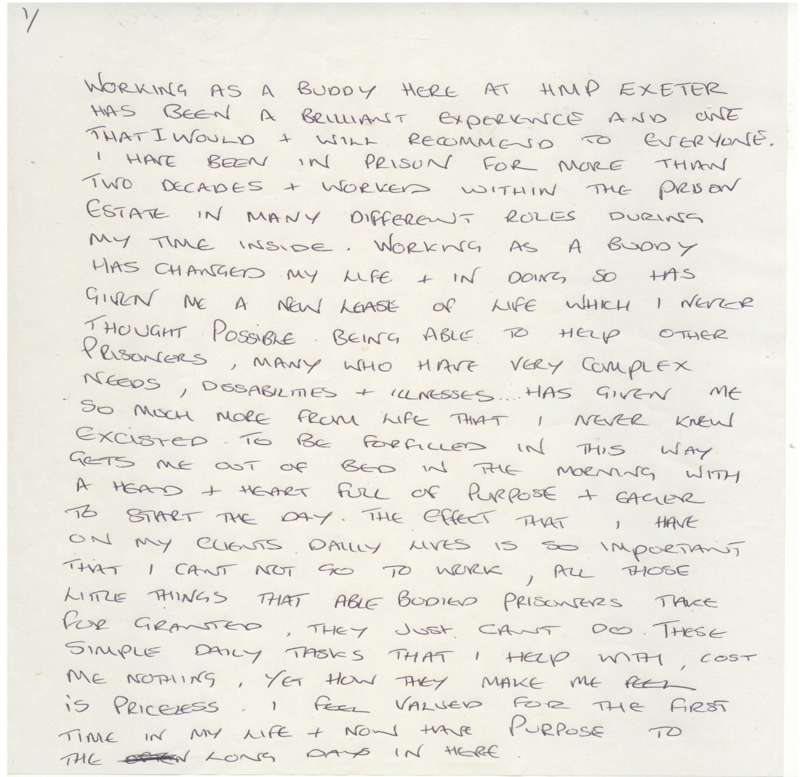
Buddie Statement Page 1
Notes:
Buddy Statement Page 1

Slide 10
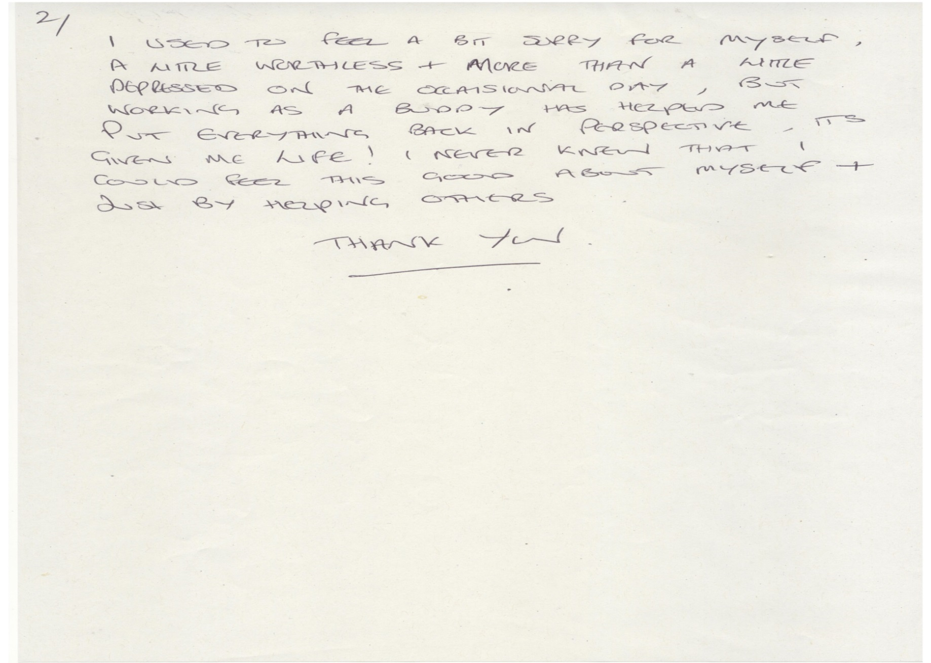
Buddie Statement Page 2
Notes:
Buddy Statement Page 2

Slide 11
Buddy Support Worker Certificate
.
Notes:
Buddy support worker certificate

Slide 12
Expert Witness Statements
When the buddies are on the wing it gives several of the residences of F wing a new lease of life. Last week we had a man from the chapel come on the wing with his guitar. The buddy had residents and staff singing away, and has asked the man if could find some older songs that some of the residents would remember.
During the course of my day, I was requires to carry out a mandatory drugs test on a blind prisoner. This involved a journey to the MDT suite and the taking of a urine sample.
The prisoner was assisted by his Buddy XXX whom I have met on numerous occasions. I would like to outline how professional, caring and helpful XXX was during this delicate time. XXX is always polite and helpful on the wing and always carries out his tasks in a caring and thoughtful manner. He is always willing to assist staff and prisoners at any time and never complains. He is a pleasure to know and Arch Tor is a better place with his help and support. He is a credit to the Buddy scheme and I feel his service should be correctly rewarded.
Notes:
Expert Witness State
ment 1

Slide 13
Expert Witness Statements
The role of the Buddy is as a support worker for the less able bodied on the wing.
As a wing officer it relieves the pressure on us all, making sure they have their meal, cleaning their cells and anyone in a wheelchair, pushing them around, especially to healthcare which facilitates a lift which they are trained to use. All in all a useful addition to the establishment.
I was impressed with the standard of care and concern shown by the buddies towards Mr ...... who was a palliative care resident on F wing. Although Mr ...... was no longer lucid, 2 of the buddies would spend time in his room watching the rugby with him and talking to him about it.
Notes:
Expert Witness State
ment 2

