Slide 1

Management and care of older prisoners
Butler Trust
5th November 2015

Slide 2
Prison Reform Trust
Media and policy work
Research
Programmes
Advice and information service
Website, e-newsletter, factfile
Notes:
I hope that some of you are familiar with our work already but
PRT is a small charity with 2 main aims – first is to reduce the numbers of people going to prison and the second is to improve prison conditions
We have a variety of roles –We lobby parliament, talk to MPs and civil servants and we work with media to draw attention to areas of concern and put out press statements, we write a lot of consultations in response to any new policy
Research programme
Programmes – care review, womens programme mental health and learning disability and out for good,
3) We have an advice service that gives information and advice to prisoners, their families and people working with prisoners – respond to around 6000 queries a year on all aspects of the prison system
We also have a website with huge amounts of information on it, we get about 56,000 hits a month on the website and we produce a monthly email newsletter – annual fact file and also a short briefing

Slide 3
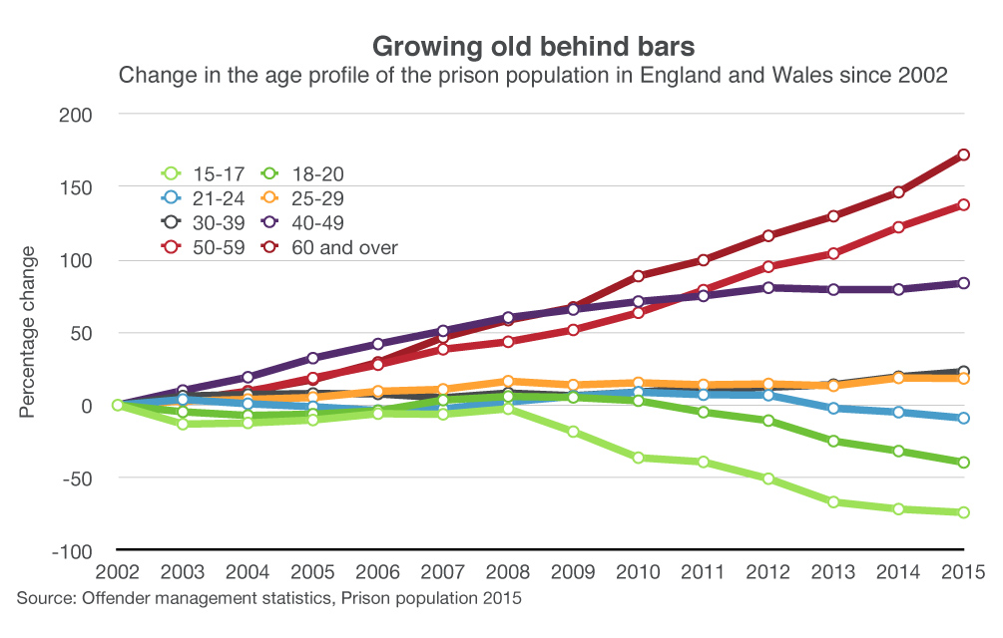
The numbers
Notes:
People aged 50 and over currently make up 14% of the prison population – nearly one in seven
There are 11,980 people aged 50 and over in prison in England and Wales— 4,109 are aged 60 and over.597
On 31 March 2014 there were 102 people in prison aged 80 and over.
Five people in prison were 90 or older.
Sentencing trends
Generally sentences are getting longer
The average prison sentence is more more than threes months longer than in 2002 – at 15.8 months - 84,000 people
this accounts for 2/3rds of the rise in the prison population
People serving 4 years and more and indeterminate sentences s 1 in 4 sentenced prisoners
Ipps and lifers are 18%
12,000 people on life and ipps – on 30 June 2015
Average 17 years up from 13 years in 2001
2,177 older people serving indefinite sentences
Estimate is that there could be 6000 over 60 by the end of the decade ....

Slide 4
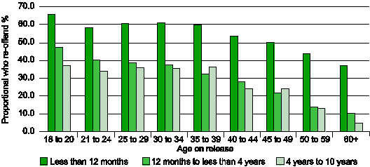
Proportion who re-offend %
Age on Release
Less than 12 months
12 months to less than 4 years
4 years to 10 years
Notes:
important to look at reoffending rates, indication of risk and dangerousness
Proven re-offending rates of offenders released from custody in the 12 months ending June 2011
Chart demonstrates the incidence of re-offending in the prisoner population after release, broken down by age at release. It is clear that across all three sentence lengths shown above, the older the prisoner is on release the less likely they are to reoffend. This is particularly extreme in longer sentence lengths: those released after a sentence of four to ten years over the age of 60 had a reoffending rate of 4.8% in contrast to 36.9% of the 18-20 year old group. The declining likelihood of re-offending draws a clear distinction in the resettlement needs of older prisoners from the younger prisoners. Prisoners over the age of 60 are also more likely to successfully complete their licence conditions; 88.6% in contrast to 76.3% of all offenders.
Despite this there is still serious concern that certain older prisoners may re-offend and in particular many older prisoners who were sex offenders will be considered high risk.

Slide 5
Four main profiles?
Repeat prisoners – ‘revolving door’ people in and out of prison for less serious offences
Growing old in prison – sentenced to a long sentence before the age of 50
Short term, first time prisoners – fraud etc
Long term first time prisoners – historical offences
Notes:
Not a homogenous group – difference between 51 and 75
Still a lot of debate about who is an older prisoner
Don’t think these profiles are perfect but they are a start......... Help to inform a strategy? Identify areas of support for different groups

Slide 6

Needs
Mental health
Disability
Social care

Slide 7
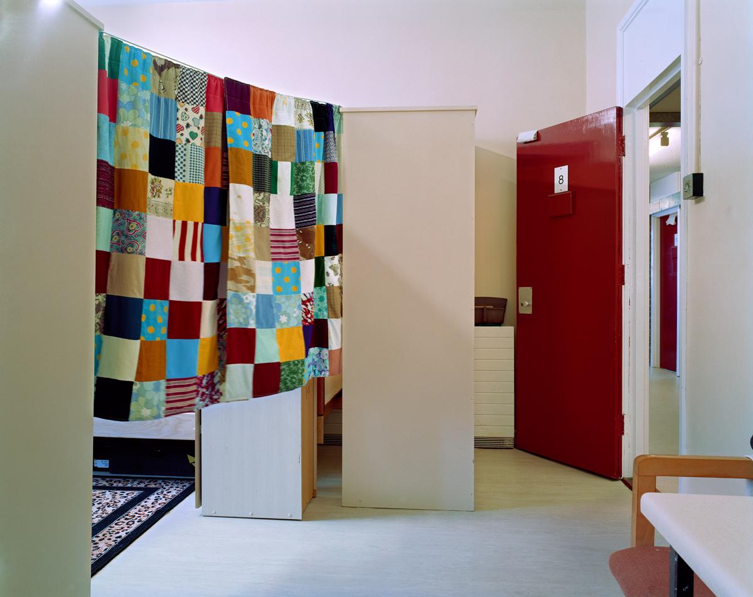
Needs
Isolation
Sentence planning
Resettlement

Slide 8
Prison’s own assessments of their services for older people 1-5
1 – full participation 5 - little participation
Prisons own rating | Number of prisons (out of 91)
1 | 6
2 | 25
3 | 37
4 | 19
5 | 4
Notes:
So – how well are prisons doing in this area – (this is research from 5 years ago)
Prison staff were asked to make their own assessment of their services for older people
1 where older people fully participated in all areas of prison life
5 where there were few activities for older people and little participation
This is how prison staff identified the quality of their services for older people – only 6 prisons felt that older people fully participated in prison life , the others had some way to go
We also asked prisons a similar question about compliance with the Disability Discrimination Act (Equality Act now– the ratings were quite similar
Six prisons also said their prisons were fully accessible
In our survey, prisoners aged 50 or older continued to be more positive about most aspects of prison life than their younger counterparts, although they were more likely to say they had been victimised because of their disability, medication, age or the nature of their offence. The positive survey responses from older prisoners sometimes obscured the inconsistent nature of their care. Provision for older prisoners varied between prisons and the lack of consistency over basics – such as unlocking retired prisoners during the core day or requiring retired prisoners to pay for their televisions – pointed to the need for a clear, uniform strategy setting out minimum requirements for their care. Prisoners with disabilities continued to be more negative in our survey about many key aspects of prison life. We regularly found that disabled prisoners were not reliably identified, so the needs of many requiring help or reasonable adjustments were not met. The removal of disability liaison officers in many prisons following the benchmarking process had also affected appropriate care provision. From April 2015, the Care Act 2014 would give local authorities new responsibilities for meeting the care needs of prisoners and we were concerned that in many prisons too little had been done to prepare and plan for these new arrangements.
In our survey, prisoners aged 50 or older continued to be more positive about most aspects of prison life than their younger counterparts, although they were more likely to say they had been victimised because of their disability, medication, age or the nature of their offence. The positive survey responses from older prisoners sometimes obscured the inconsistent nature of their care. Provision for older prisoners varied between prisons and the lack of consistency over basics – such as unlocking retired prisoners during the core day or requiring retired prisoners to pay for their televisions – pointed to the need for a clear, uniform strategy setting out minimum requirements for their care. Prisoners with disabilities continued to be more negative in our survey about many key aspects of prison life. We regularly found that disabled prisoners were not reliably identified, so the needs of many requiring help or reasonable adjustments were not met. The removal of disability liaison officers in many prisons following the benchmarking process had also affected appropriate care provision. From April 2015, the Care Act 2014 would give local authorities new responsibilities for meeting the care needs of prisoners and we were concerned that in many prisons too little had been done to prepare and plan for these new arrangements.

Slide 9

What makes a difference?
Core day unlock
Consultation
Groups and socialisation
Adapted work, education, activities,
Staff lead engaged
Pay
Peer support
Notes:
Core day unlock
Groups and socialisation
Staff lead engaged (training and management support)
However, the survey revealed much good practice with older people in prison was taking place. Thirty two prison staff (over a third of the survey respondents) explained that a forum, focus group or committee for older prisoners was running in their establishment. Nearly two thirds of the 92 prisons in the survey (60%) reported that some specific age related assessments or arrangements were in place. Respondents from thirty prisons (almost a third of the survey) noted that there was some form of prisoner to prisoner support in the prison for older people. Over a third of prisons (38%) have some outside organisations providing some services to older prisoners.
pay for prisoners of pensionable age
oppotrunities to work part time
No deductions for tv
Losing enhanced (if maintaining innocence)

Slide 10
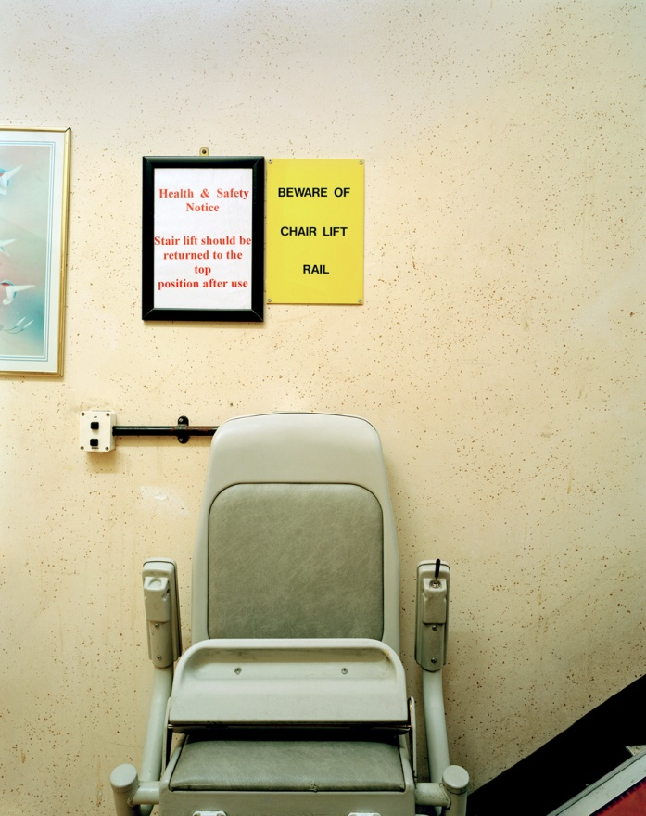
Recommendations -outside NOMS
Long term change in sentencing and more community penalties
Diversion to social care at sentence and appropriate accommodation during sentence
Links and agreements with sheltered accommodation and care homes for release

Slide 11
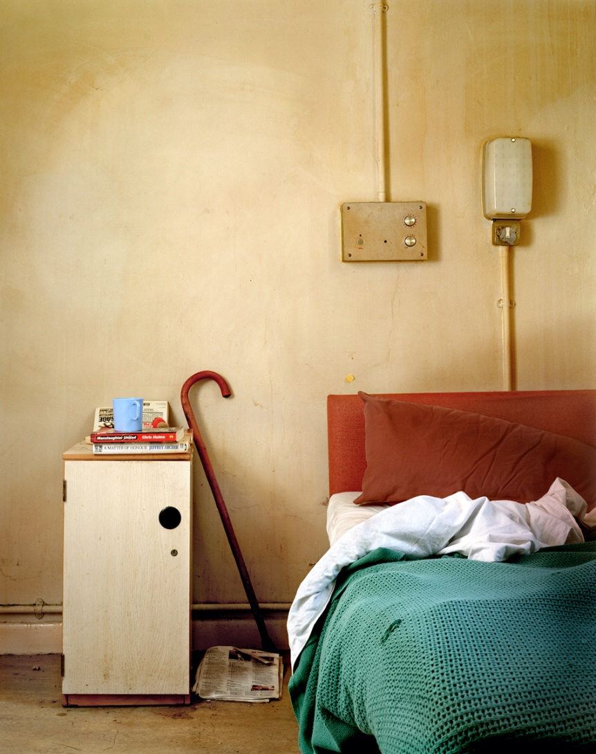
Recommendations for NOMS
National strategy
Older peoples leads in prisons
Appropriate allocation
More use of compassionate release, home detention curfew, release on temporary licence
Develop supported accommodation and approved premises

Slide 12
Prison Reform Trust publications
Booklet for people on licence for a sex offence
(out now)
Factfile
Information book for prisoners with a disability
Research into use of segregation units
Resettlement experiences of older people

Slide 13

Thank you for listening!
www.prisonreformtrust.org.uk
Francesca.cooney@prisonreformtrust.org.uk

